Slide 1


Spoke-Darts for High-Dimensional Blue-Noise Sampling
Scott A. Mitchell ACM TOG 37:2, May 2018 Scott A. Mitchell, Mohamed S. Ebeida, Muhammad A. Awad, Chonhyon Park, Anjul Patney, Ahmad A. Rushdi, Laura P. Swiler, Dinesh Manocha (now UMD), Li-Yi Wei
SIGGRAPH 2018 18 minutes talk 15 Aug 10:45 am West Building, Room 109-110

Slide 2
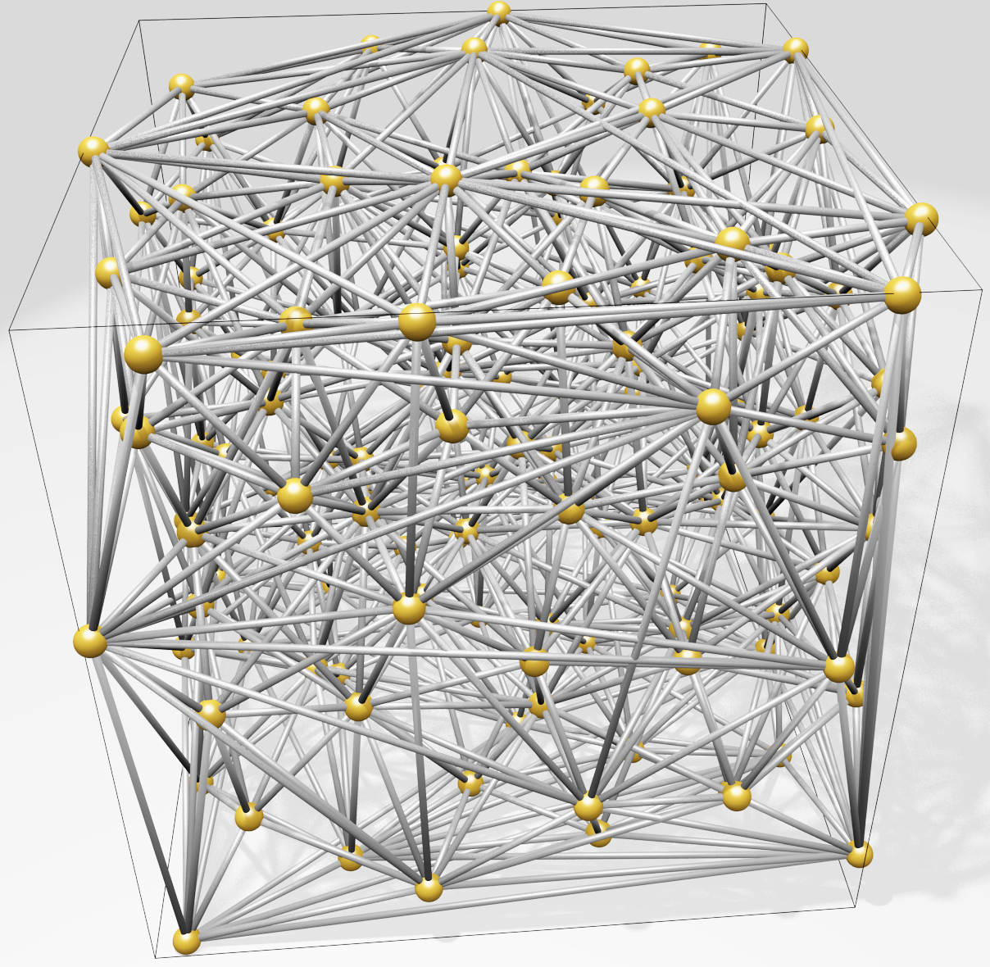
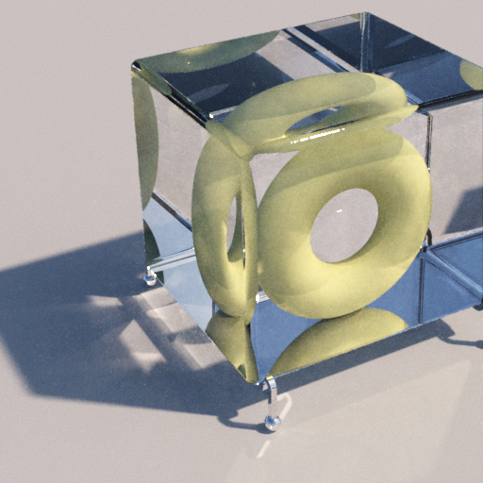
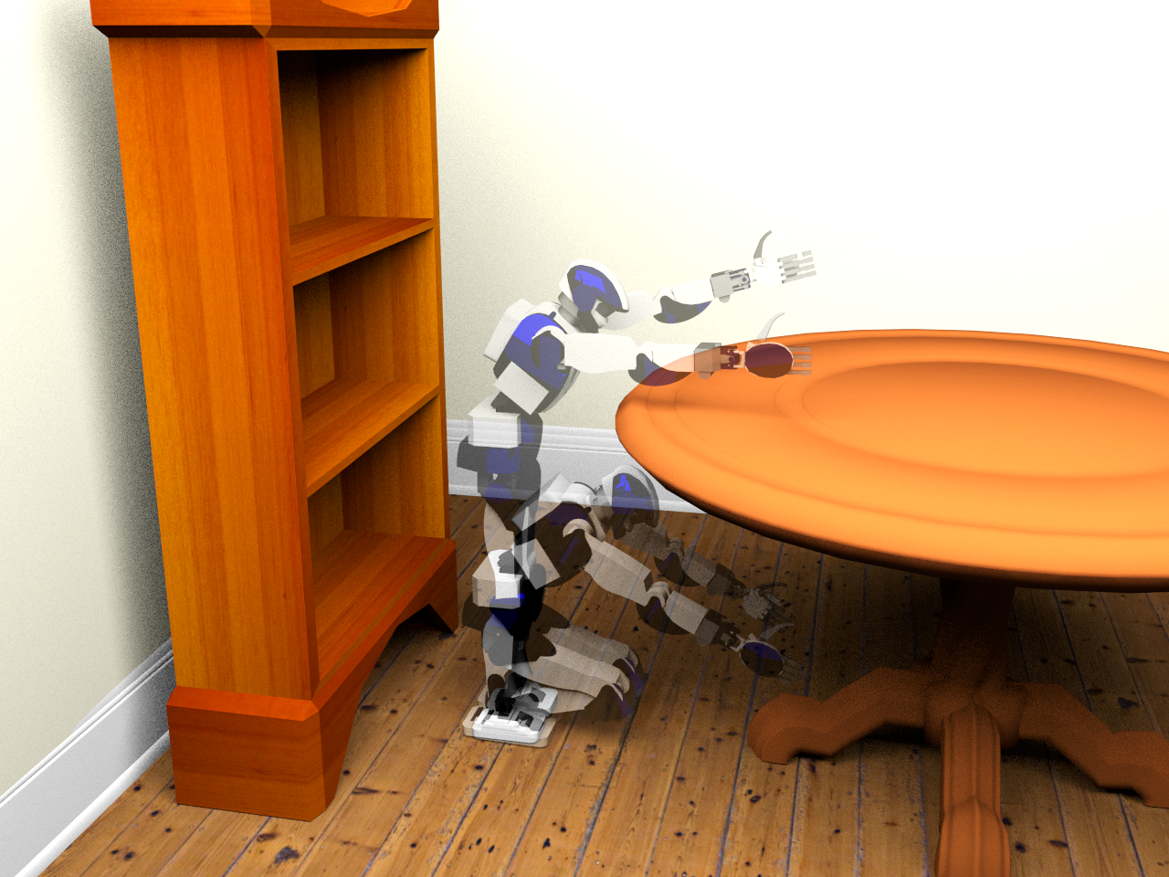
Motivation
High-dimensional blue-noise sampling is useful but hard to generate especially adaptively!
Render
Geometry
8-100D: approximate Delaunay Graphs (Voronoi neighbors)
8D: proof-of-concept path tracing
23D: find a path in robot configuration space
Motion Plan
Optimize
100D: adaptively explore black-box function to find global minimum

Slide 3
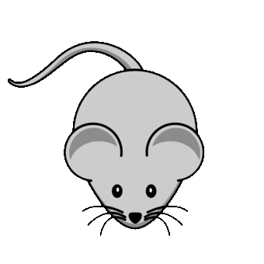

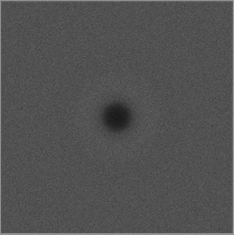
Motivation
Maximum
domain-to-sample distance
Goal: algorithm to produce point distributions
Requirements
Output: blue-noise, uniform-random point distribution except
No points too close
No big gaps
Process
Memory & time scales well to high dimensions (e.g. 20D)
Locally adaptive, general domain shapes
Confidence: provable guarantees on output quality
Minimum sample separation
RP Radial Power
RDF Radial Distance Function

Slide 4
Motivation
Maximum
domain-to-sample distance
Goal: algorithm to produce point distributions
Requirements
Output: blue-noise, uniform-random point distribution except
No points too close
No big gaps
Process
Memory & time scales well to high dimensions (e.g. 20D)
Locally adaptive, general domain shapes
Confidence: provable guarantees on output quality
Goal: algorithm to produce point distributions
Requirements
Output: blue-noise, uniform-random point distribution except
No points too close
No big gaps
Process
Memory & time scales well to high dimensions (e.g. 20D)
Locally adaptive, general domain shapes
Confidence: provable guarantees on output quality
Goal: algorithm to produce point distributions
Requirements
Output: blue-noise, uniform-random point distribution except
No points too close
No big gaps
Process
Memory & time scales well to high dimensions (e.g. 20D)
Locally adaptive, general domain shapes
Confidence: provable guarantees on output quality
Goal: algorithm to produce point distributions
Requirements
Output: blue-noise, uniform-random point distribution except
No points too close
No big gaps
Process
Memory & time scales well to high dimensions (e.g. 20D)
Locally adaptive, general domain shapes
Confidence: provable guarantees on output quality
Minimum sample separation
RP Radial Power
RDF Radial Distance Function

Slide 5
What’s wrong with the algorithms we already have?
SimpleMPS guarantees saturation
runtime & memory
divide domain into cubes, diagonal length r while ∃cubes, and cube diagonal > machine precision do (A(d) × #cubes) times: pick a cube pick candidate sample from cube if distance(candidate, prior samples) > r accept candidate as sample discard cube refine remaining cubes discard covered cubes
darts
refine
darts
refine
SimpleMPS, “A Simple Algorithm for Maximal Poisson-Disk Sampling in High Dimensions,” Eurographics 2012.

Slide 6
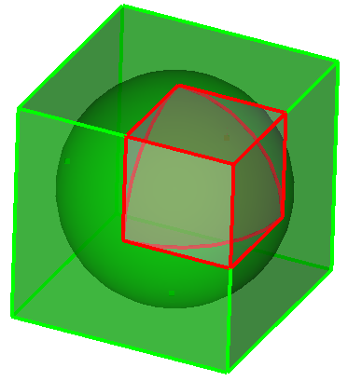
What’s wrong with the algorithms we already have?
SimpleMPS guarantees saturation … but doesn’t scale by dimension, d. ☹
runtime & memory
Problem: cube poorly approximates sphere Exponentially worse as dimension increases More empty boxes, memory limit d≈6
darts
…
refine
d=1
V(cube) = 1
V(sphere) = 1
d=2
V(cube) = 1
V(sphere) = 0.785…
d=3
V(cube) = 1
V(sphere) = 0.523…
d→∞
V(c) = 1
V(s) → 0
darts
Any algorithm that constructs (an approximation of) remaining sample space is doomed to be exponential-in-d
refine
SimpleMPS, “A Simple Algorithm for Maximal Poisson-Disk Sampling in High Dimensions,” Eurographics 2012.

Slide 7
What’s wrong with the algorithms we already have?
Bridson 2007* scales
runtime & memory
Front set = one sample do prior_sample = randomly pop Front do pick candidate from (r,2r) annulus around prior_sample if distance(candidate, all samples) > r accept candidate as sample add candidate to Front until 30 consecutive rejections until Front is empty
Bridson 2007 pseudocode, modified for exposition
30+ depending on dimension
*Modified to eliminate a background grid and exponential-in-d complexity.
Bridson 2007, "Fast Poisson disk sampling in arbitrary dimensions." SIGGRAPH '07 sketch.

Slide 8
What’s wrong with the algorithms we already have?
Bridson 2007* scales … but doesn’t guarantee saturation ☹
runtime & memory
Trivial bound on empty volume in one annulus.
Unknown if saturated outside all annuli?
?
Bridson 2007, "Fast Poisson disk sampling in arbitrary dimensions." SIGGRAPH '07 sketch.

Slide 9
Proposed algorithm
Spoke-Darts scales
runtime & memory
Front set = one sample do prior_sample = randomly pop Front do pick candidate from radial line through (r,2r) annulus around prior_sample if distance(candidate, all samples) > r accept candidate as sample add candidate to Front until 12 consecutive rejections until Front is empty
Spoke-Darts change from Bridson in red
12 same for all dimensions
O
Spoke-Darts for High-Dimensional Blue-Noise Sampling, TOG 72:2, SIGGRAPH 2018.

Slide 10
Proposed algorithm
Spoke-Darts scales … and guarantees saturation ☺
runtime & memory
Provable bound on size of a void outside all annuli!
!
Spoke-Darts for High-Dimensional Blue-Noise Sampling, TOG 72:2, SIGGRAPH 2018.

Slide 11
Suppose there is void outside all disks
Proof of saturation
Spoke-Darts scales … and guarantees saturation
One disk
Missed 12 times, so area is probably small, R = area(shared) / area(disk)
i.e. Probability of 12 misses = 𝝥 (1-R)¹² < e^{(-12R)}
All disks Probability all missed = product of probabilities
p = 𝚷 e^{(-12 R_i)} = e^{-12 𝚺 R_i}. So area sum is small.
Small surface area → small void radius
No big gaps!

Slide 12
Structure of saturation guarantee
Magic values for dimensional independence
e.g.
where
chance beta exceeded
#misses, failed candidates
dimension
you get to pick any three

Slide 13
Output Quality
saturation in practice similar?
narrowing beta as d increases
runtime, save about one dimension vs Bridson 2007, primitives are point in sphere? Trim segment by sphere

Slide 14
Output Quality
line vs point vs MPS
output distribution sharp discontinuity
try non-uniform by length, problem of any sharp rule, local distribution -> discontinuity global
doing better, mimic two radii sampling with using two lines
“Variable Radii Poisson-Disk Sampling,” CCCG 2012.

Slide 15
Proposed algorithm: Two-Spokes for Soft Blue Noise
Animate algorithms

Slide 16
Output Quality
Two-spokes – show flat rdf and rp and spectra
Price is b=4 not 2
Price is longer runtime, larger radius relative to minimum distance
Show spectra of true two-radii

Slide 17
Conclusions
Free software
SpokeDartsPublic on github: https://github.com/samitch/SpokeDartsPublic
Want high-d blue noise?
Use spoke-darts line sampling
Supports adaptive sampling over general domains
Nearly as easy to implement (especially since I already did that for you :) and runs faster, than Bridson 2007
Want blue-noise with better spectrum?
Use two-spokes variant
Takes longer
Open problems
Prove non-trivial saturation-bound on Bridson 2007?
Does saturation matter for high-d rendering, etc.?

Slide 19
Proposed algorithm
Spoke-Darts scales … and guarantees saturation ☺
runtime & memory
Front set = one sample do prior_sample = randomly pop Front do pick candidate from radial line through (r,2r) annulus around prior_sample if distance(candidate, all samples) > r accept candidate as sample add candidate to Front until 12 consecutive rejections until Front is empty
Bridson 2007 pseudocode, modified for exposition
nada
Spoke-Darts for High-Dimensional Blue-Noise Sampling, TOG 72:2, SIGGRAPH 2018.

Slide 20
Proposed algorithm
Spoke-Darts scales … and guarantees saturation ☺
runtime & memory
Front set = one sample do prior_sample = randomly pop Front do pick candidate from radial line through (r,2r) annulus around prior_sample if distance(candidate, all samples) > r accept candidate as sample add candidate to Front until 12 consecutive rejections until Front is empty
Bridson 2007 pseudocode, modified for exposition
Spoke-Darts for High-Dimensional Blue-Noise Sampling, TOG 72:2, SIGGRAPH 2018.

